Slide 1
Introduction to…
www.mpsag.com
01/14/2016

Slide 2
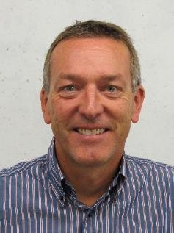
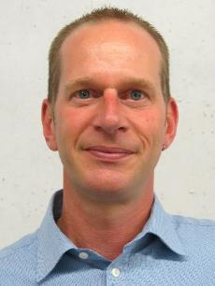
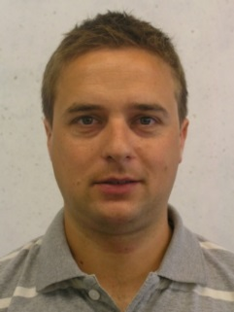
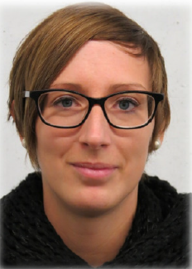
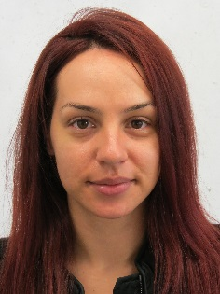
The Team
Gregoire Bagnoud
Director Business Development
(Head of Sales and Marketing for MPS Microsystems)
Phone: +41 32 344 44 72
Mobile: +41 79 286 38 55
gregoire.bagnoud@mpsag.com
Oliver Aubry
Product Manager
(Responsible for microlinea product lines)
Phone: +41 32 344 43 07
Mobile: +41 79 798 69 88
oliver.aubry@mpsag.com
Romain Schlüchter
Project Manager
(microlinea products)
Phone: +41 32 344 43 53
romain.schluechter@mpsag,com
Muriel Ansermet
Sales & Export Administrator
Phone: +41 32 344 43 25
muriel.ansermet@mpsag.com
Odeta Bylykbashi
Marketing Administrator
Phone: +41 32 344 43 24
odeta.bylykbashi@mpsag.com

Slide 3
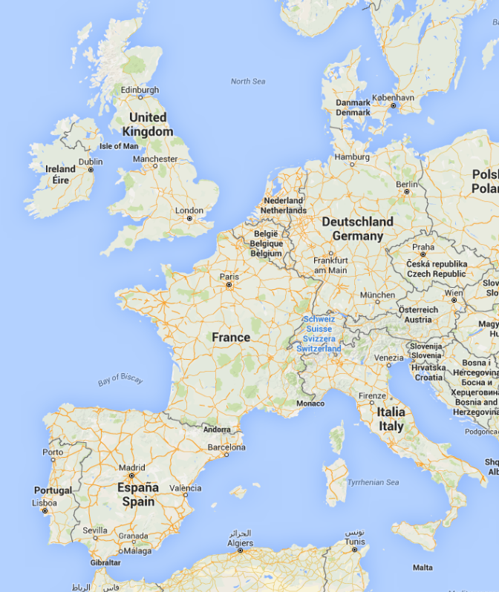
Where do we come from?
From the heart of Europe

Slide 4
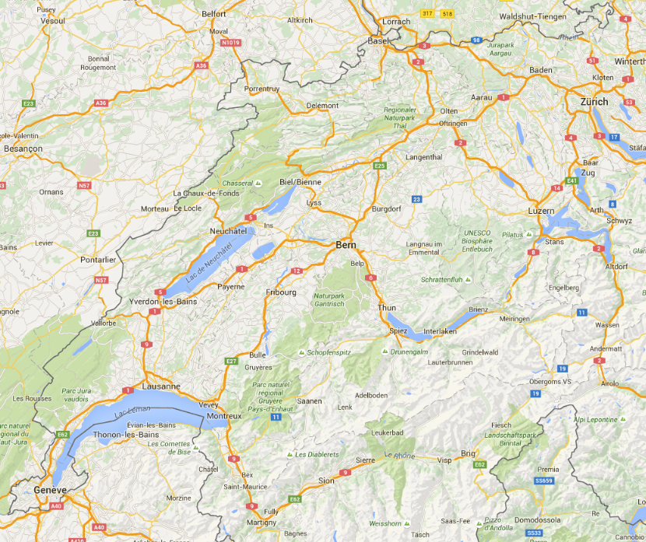
All roads lead to … mps!
Basel Airport → Biel/Bienne:
95km
1h15 by car
1h35 by train
Basel Airport
Zurich Airport
Biel/Bienne
Zurich Airport → Biel/Bienne:
120km
1h30 by car
1h30 by train
Geneva Airport → Biel/Bienne:
153km
1h45 by car
1h40 by train
Geneva Airport

Slide 5
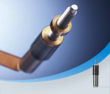
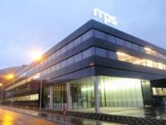
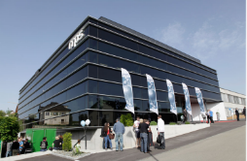
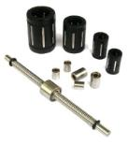
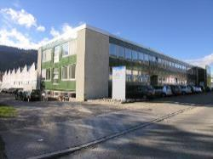
A young company with a long experience
founded and joined
Family founded
Bonfol plant opening
New Building 14’400 m2
Bonfol Building extension
1936
1948
1967
1973
1999
2003
2008
2008
2012
2013
4 point contact bearing concept developed by mps

Slide 6
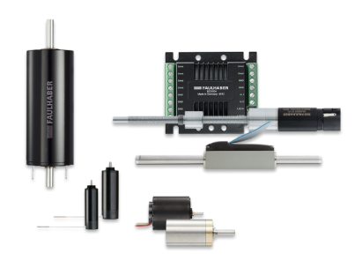
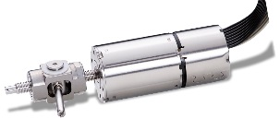
FAULHABER Group
Headquartered in Schönaich, Germany
International R&D and Production Locations:
4 R&D Centers
5 Production Centers
International Sales & Service Locations:
7 Sales & Service Locations
24 Sales and Distribution Partners
17 Subsidiaries and Partnerships
1,600 Employees
US$ 240 Mio Revenue

Slide 7
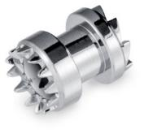
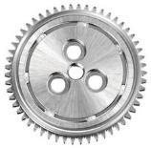
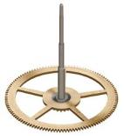
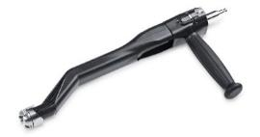
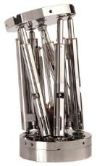
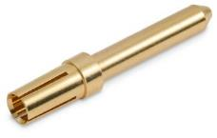
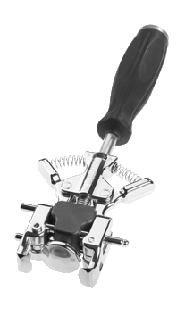
MPS Group Organization
MPS Group
MPS Watch
MPS Precimed
MPS Décolletage
MPS Microsystems
400 employees
USD 70 Mio annual sales
130 employees
Location: Bonfol
Watch bearings and gear wheels
150 employees
Location: Bienne
Microsystems, ball screws, linear bearings
80 employees
Location: Corgémont
Orthopaedic instruments
40 employees
Location: Court
Precision Swiss turning

Slide 8
MPS Group Organization
MPS Microsystems
MPS Microsystems
150 employees
Location: Bienne
Microsystems, ball screws, linear bearings
150 employees
Location: Bienne
Microsystems, ball screws, linear bearings

Slide 9
A well equipped and modern facility in Bienne, Switzerland

Slide 10
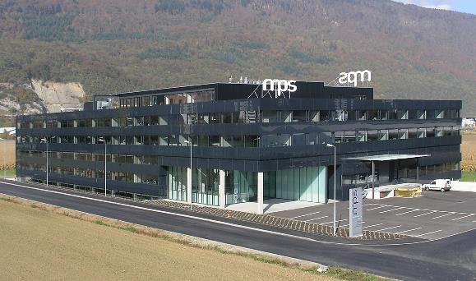
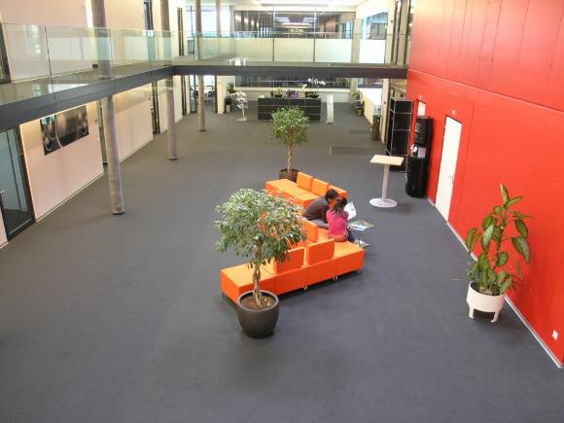
A well equipped and modern facility in Bienne
Located in Biel/Bienne, Switzerland
155’000 ft² built in 2008
150 employees
ISO 9001 – ISO 14001 - ISO 13485
Research & Development
Industrialization
Parts manufacturing :
- turning, grinding,
- ball bearing manufacturing,
- thermal and surface treatment.
Microsystems assembly (clean room)
Purchasing and logistics
Quality assurance and Quality control

Slide 11
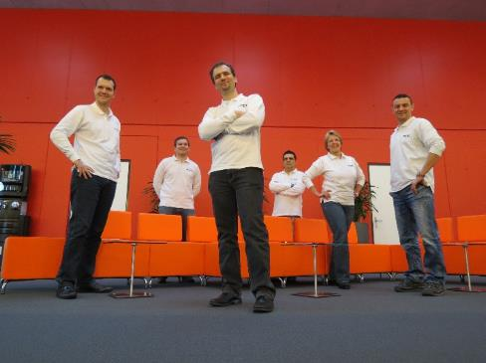
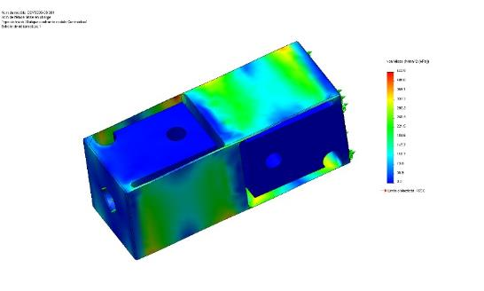
A dynamic and innovative R&D organization
RESEARCH & DEVELOPMENT
6 development engineers + 2 lab engineers
CAD “Solidworks”
FEM simulations
PDM “Teamcenter”
PROTOTYPING
Turning: Ø 0.5 -300mm
Milling: 4 axis CNC
Flat grinding
EDM / Wire EDM
TESTING
Torque testing: 1µNm – Nm
Axial Force: < 2500N
Noise measurement
Lifetime test
Development of test device for production

Slide 12
Manufacturing capabilities

Slide 13
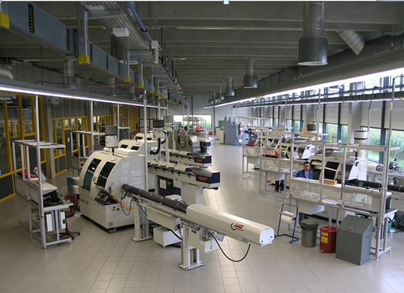
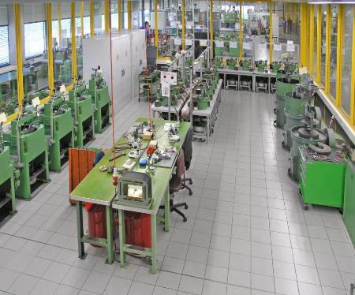
Components manufacturing for high requirements
TURNING
Rod size from Ø2 to Ø42 mm ± 3µ
GRINDING
Inner- / Outer grinding ± 0.5µ
Thread and form grinding
Center less grinding
Lapping/Polishing 10 nm (roughness)
BALLS MANUFACTURING
Ø 0.130 – 1.588 mm (ISO Grade 3 )
Sphericity 0.08µm - Surface roughness max 0.01µm
Stainless steel and Zirconium oxide
PARTS CLEANING & HEAT TREATMENT
Tumbling and cleaning
Quenching/ Precipitation hardening, Cryogenics, Tempering
Deburring

Slide 14
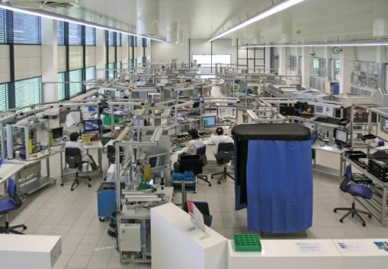
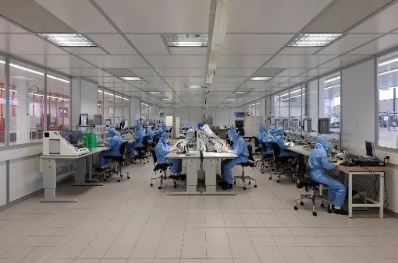
Microsystems assembly dedicated to precision
ASSEMBLY AREA
Dust free area (10’800m2)
Clean room class ISO 7 (2’100m2)
Product dedicated assembly lines
TECHNOLOGIES
Cleaning
Pairing in ¼ micron
Riveting
Press fit
Gluing (UV, anaerobic)
Precision Lubrication
Laser welding
Balancing
Specific measurement
Visual inspection
Assembly under laminar flow boxes – ISO 6

