Slide 1
Products and Technologies

Slide 2
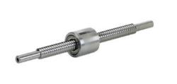
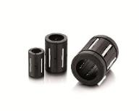
MPS Microsystems products and applications
Ball screws Linear bearings (L-series) Linear bearings (DBL-series) | Active implants Medical robotics Automation Optics Measuring systems Defense

Slide 3
Product line
Market share per product
Examples of applications

Slide 4
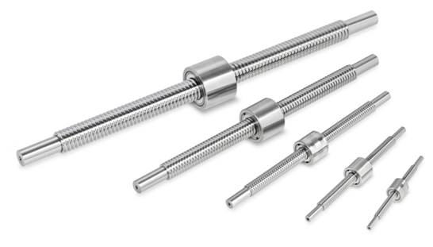
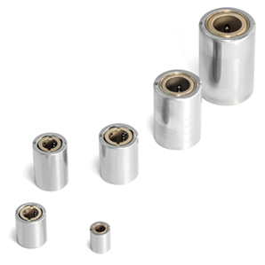
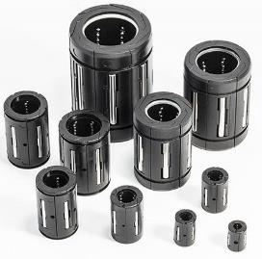
Precision ball screws & linear bearings
LINEAR BEARINGS – DBL Line
Miniature high precision linear bearings
Cost effective DBL – series with plastic body (POM) and stainless steel balls and needles.
Bore diameter : ø 3 … ø 40 mm
Outside diameter : ø 7 … ø 40 mm
LINEAR BEARINGS – L Line
Miniature high precision linear bearings
Bore diameter : ø 2 … ø 6 mm
Precision : 0 up to 8 µ
Outside diameter: ø 4 … ø 12 mm
Custom solution with zero radial play (preloaded) with housing diameter up to 30 mm.
BALL SCREW
Miniature high precision ball screw with positioning accuracy < 5 µ
screw size: ø 4.25 … ø 13.6 mm
High efficiency and high smoothness
Lubricant free option
Reliability (Long service life)

Slide 5
Precision ball screws & linear bearings

Slide 6
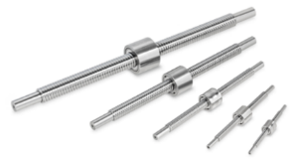
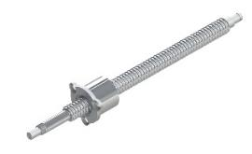
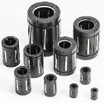
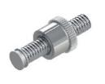
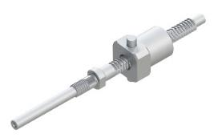
microlinea market (worldwide)
Distribution by turnover of microlinea products sold in year 2014
Total sales revenues in 2014:
$ 1‘8Mio

Slide 7
Applications
Ball screws :
Comprehensive range. Screw size: Ø 0.167in … Ø 0.535in (Ø 4.25 mm … ø 13.6 mm)
Standard axial play 0 to 0.197µin (0 to 5µm)
Reduced axial play on request
High efficiency
Customized designs
Ogival thread for a higher load capacity
Left-hand thread
Pitch
Screw (ends, length)
Nut (single, double, multiple nuts, customized outer sleeve (e.g. flange))
Multiple pitches
Lubricants (oil, grease, or dry)
Special surface treatments (passivation, dry coating)
Small series accepted

Slide 8
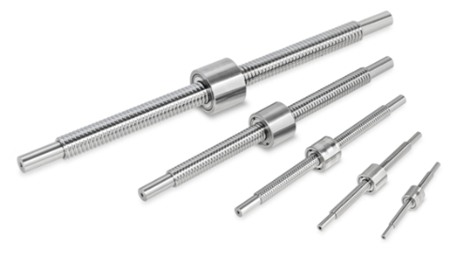
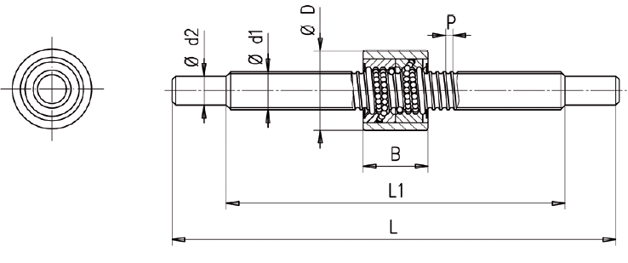
Applications
Precision ball screws

Slide 9
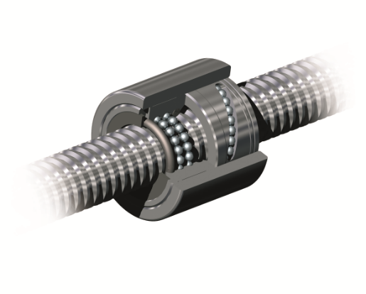
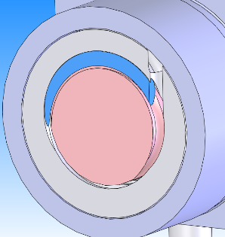
Features
Ball screws
Description | Features
Screw | • Stainless steel • Ground
2 nuts | • Stainless steel • Axial play set with the 2 nuts
Outer sleeve | • Stainless steel • In one piece = design freedom in size and shape
Recirculation | Stainless steel Integrated in the nuts Optimised pathway = extended life
Outer sleeve
Recirculation
Screw
Nut

Slide 10
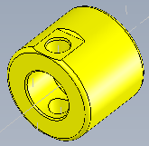
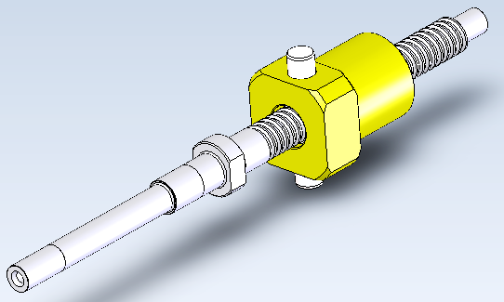
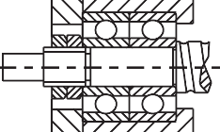
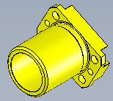
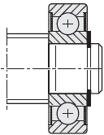
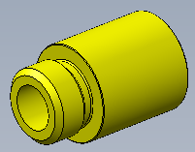
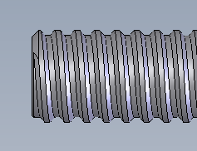
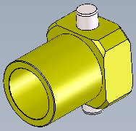
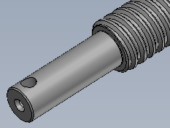
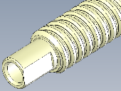
Features
Customisation possibilities
Pitch
Shape of the thread
Nut
Screw end
Dimensions
Materials, heat treatments, lubricants, surface treatments, dry lubrication, etc.
Coupling

Slide 11
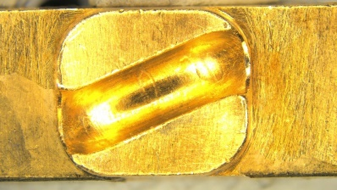
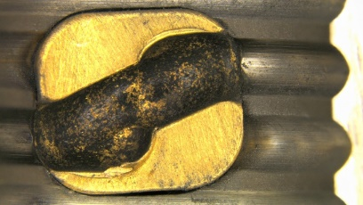
Product benefits
Ball screws
before the test
Competitor #1
MPS
 | %Ca
MPS | 90
Competitor #1 | 26-38
Competitor #2 | 36-46
after the test

Slide 12
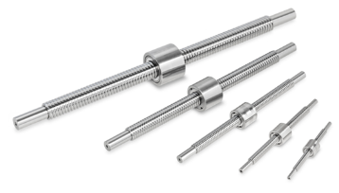
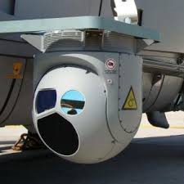
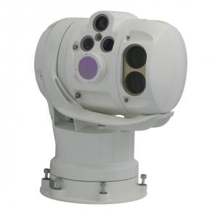
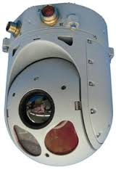
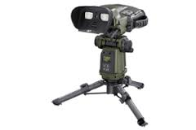
Applications
Ball screws
Optronic systems
Infrared cameras

Slide 13
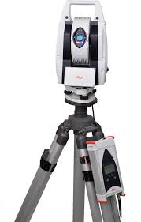
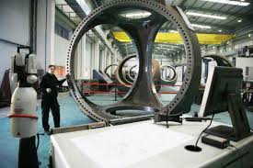
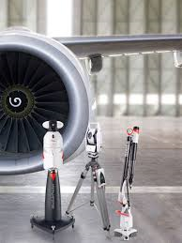
Applications
Ball screws
Laser trackers

Slide 14
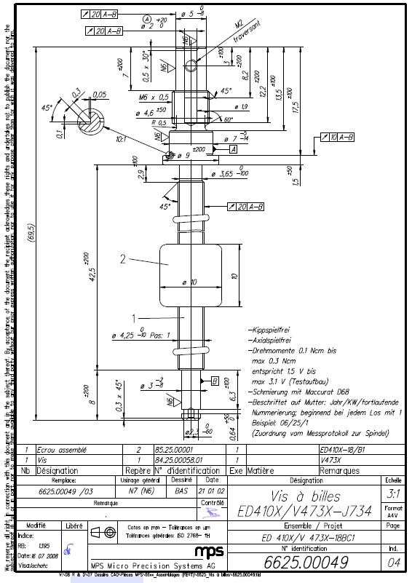
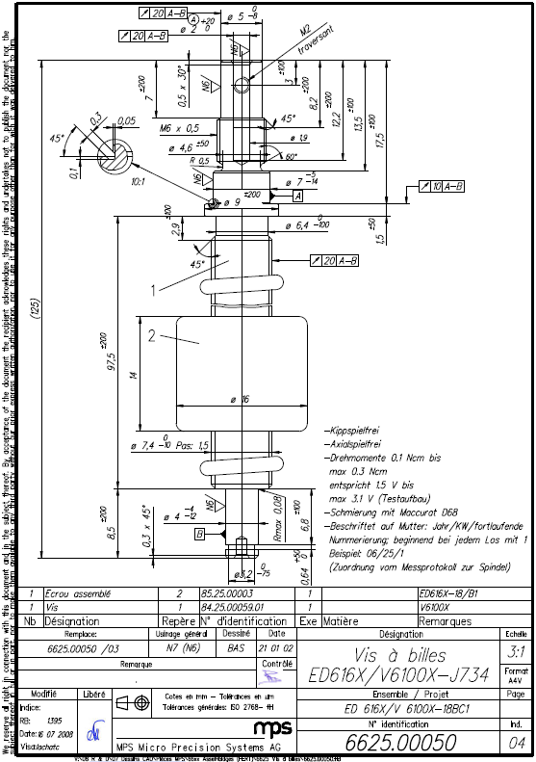
Applications
Customer: Leica
Application: Laser tracker
MPS items: Two types of ball screws per device ED410X/V473X-J734-H7 ED616X/V6100X-J734-H7
Function of MPS items: Laser beam focus system (1 to 50 m)
Main requirements:
High precision …µm
No axial or radial play
Low friction: 0.1 to 0.3 Ncm

Slide 15
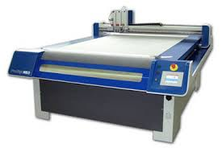
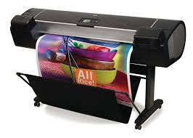
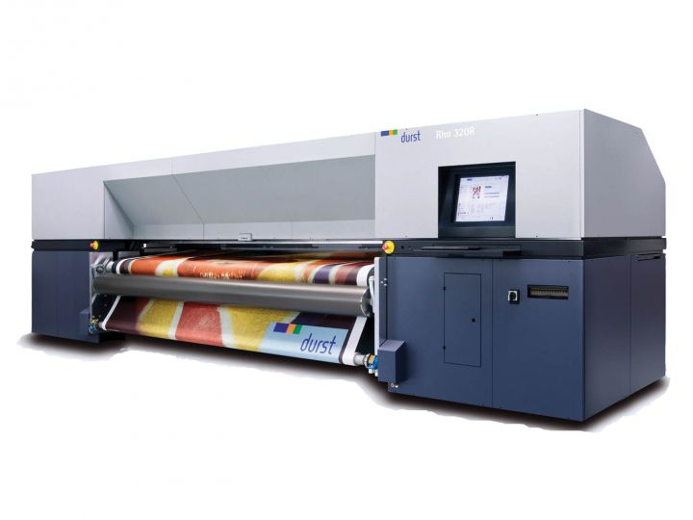
Applications
Ball screws
High-end plotters

Slide 16
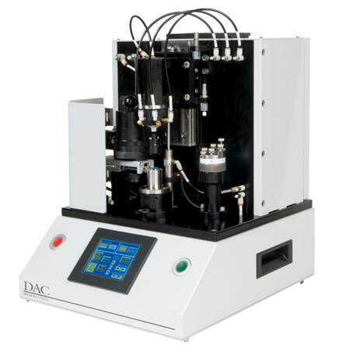
Applications
Ball screws
Equipment for lens machining process

Slide 17
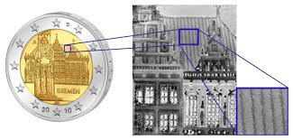
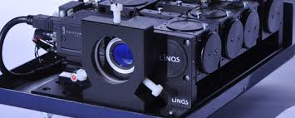
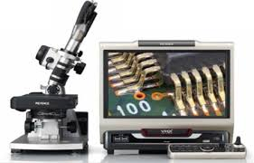
Applications
Ball screws
Holographic measurement

Slide 18
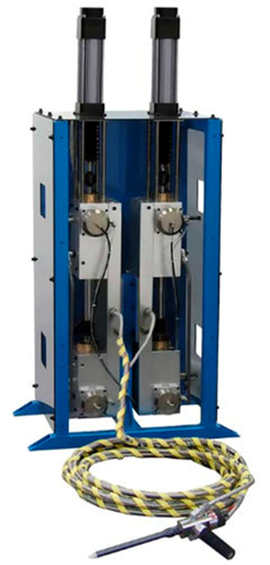
Applications
Ball screws
Dosing

Slide 19
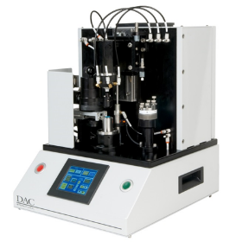
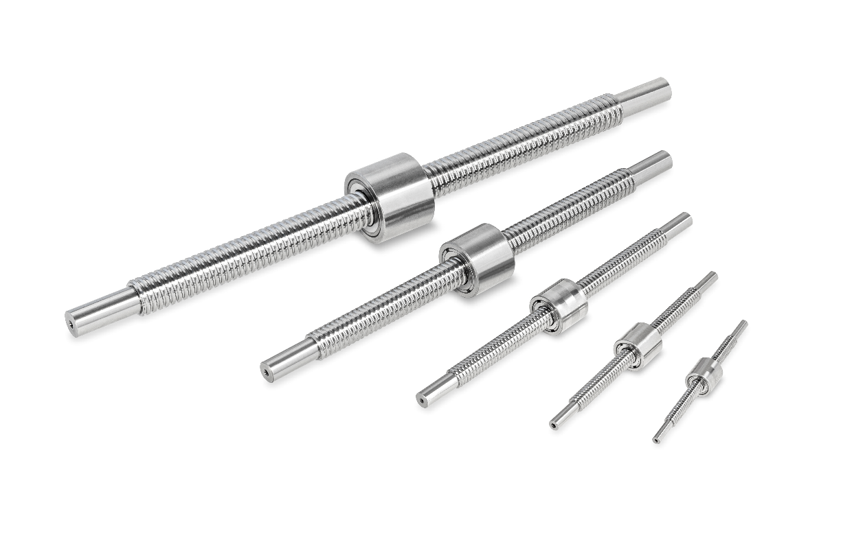
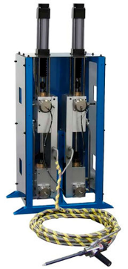
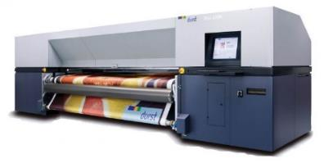
Applications with MPS ball screws
Equipment for lens machining process
Optronic systems
Infrared cameras
Holographic measurement systems
Laser trackers
High-end plotters
Dosing devices

Slide 20
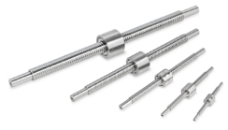
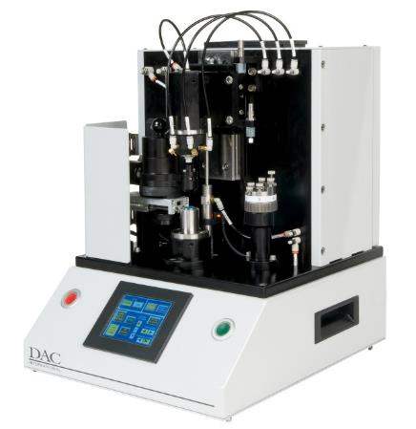
Applications
Ball screws
High precision
In the range of the µm
Reliability
Long life
Miniature – compactness
Mostly successful with the small sizes
Customization
90% of mps ball screws are customized
High efficiency
Low friction and great smoothness

