Slide 1
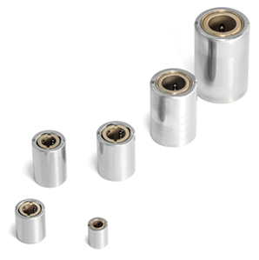
Applications
Linear ball bearings – L Line :
Bore diameter from Ø 0.078in to Ø 0.236in (Ø 2 mm to Ø 6 mm)
The smallest linear ball bearing available on the market! (L204X)
Precision
Bore diameter +0.315/0 µin (+8/0 µm)
Outer diameter 0/-0.315µin (0/-8µm)
Customized designs
All stainless steel execution
Housing up to Ø 1.181in (Ø 30 mm)
Reduced radial play (or even preloaded)

Slide 2
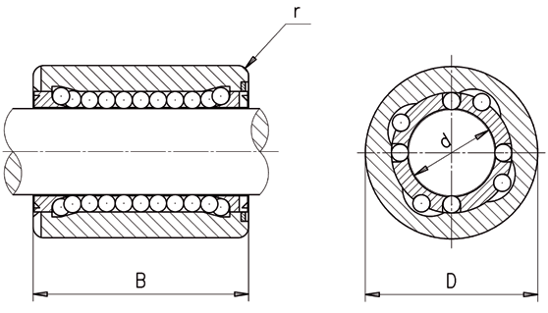
Applications
Precision linear bearings L

Slide 3
Features and competitiveness
Unique!
Ø4
Ø2

Slide 4
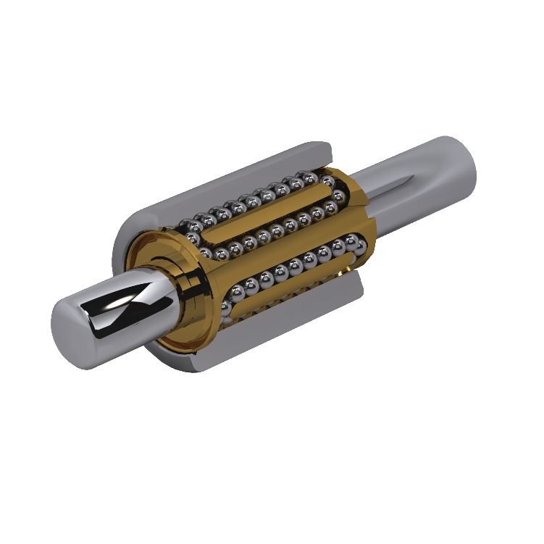
Features and competitiveness
L-type linear ball bearings
Description | Features
Outer sleeve | Stainless steel Honed (in&out) = precision for mastered radial play
Balls | Stainless steel MPS in-house Grade 3 ball production = possibility to select the right calibre (µm)
Cage / recirculation | Brass (on request: stainless steel) Optimised recirculation = extended life, low friction, smooth movement, no stick/slip effect
Shaft | Not supplied by MPS Recommended minimum hardness: 58 HRC Recommended diameter tolerances: 0/-6µm
Ø_{K}
Ø_{W}
Ø_{H}
On request, the radial play can be adjusted to 1-3µm

Slide 5
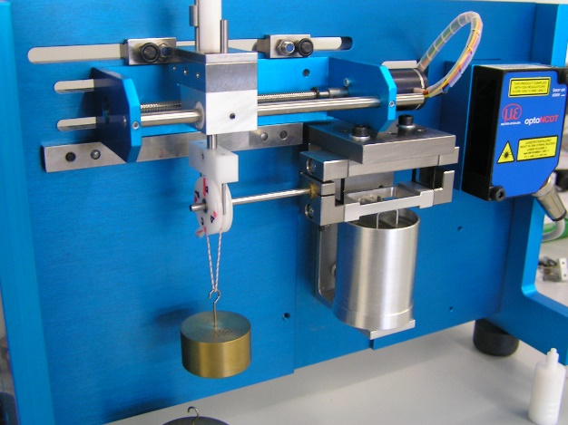
Product benefits
L-type linear ball bearing – Friction
 | [cNm] | lube
MPS | 0.45 | Oil 1
Competitor #1 | 5.5 | Oil 1
Competitor #2 | 1.15 | Grease
Tests with 0.22lbf (1N) load applied radially

Slide 6
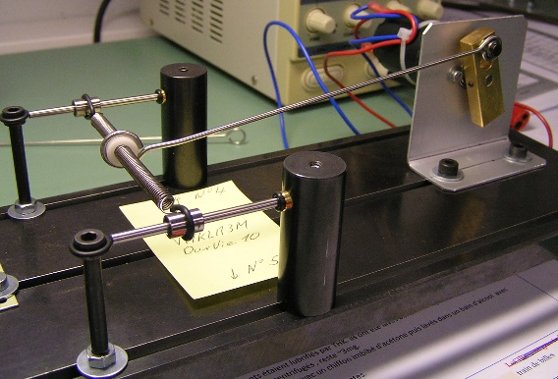
Product benefits
L-type linear ball bearing - life test
MPS (ss cage)
2'262'000
MPS (standard
1'581'651
Competitor #1
738'837
Competitor #2
594'517
0
500'000
1'000'000
1'500'000
2'000'000
2'500'000
travel before blocking [m]
65.6 ft/s (20 m/s)
3.6 lbf (16N)

Slide 7
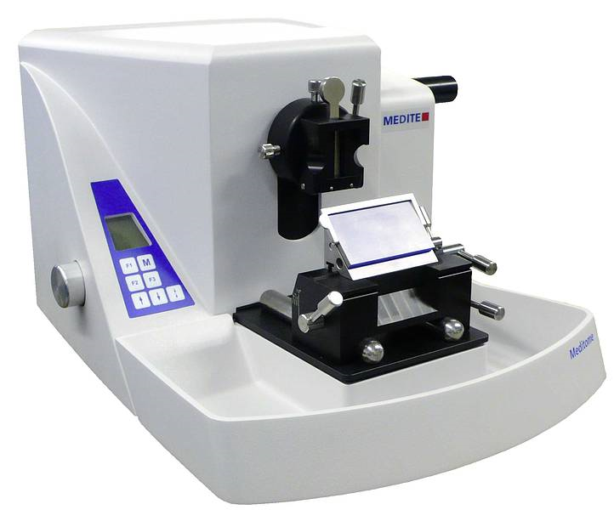
Applications
L-type linear ball bearings
Microtome

Slide 8
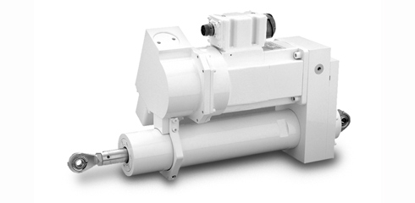
Applications
L-type linear ball bearings
Flight control

Slide 9
Applications
L-type linear ball bearings
Satellites

Slide 10
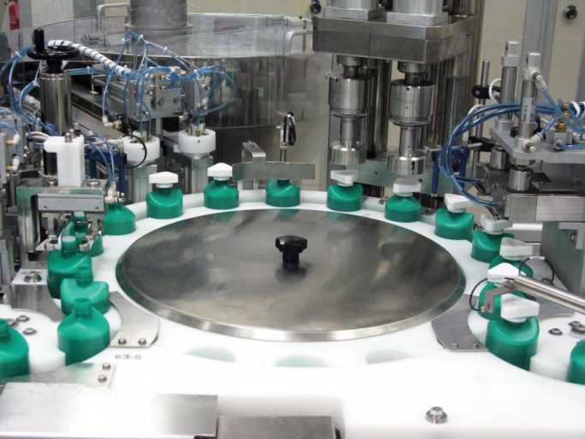
Applications
Applications – L bearings
Packaging (e.g.: pharmaceutics)

Slide 11
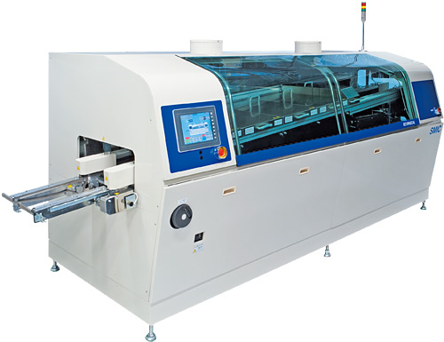
Applications
Applications – L bearings
Industry:
Soldering machine
Thermal treatment equipment
Semiconductor
Injection modules
High precision machining
Automation

Slide 12
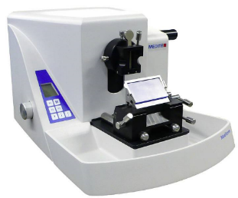
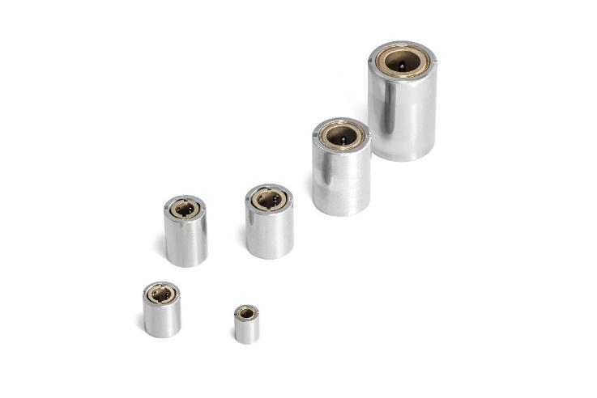
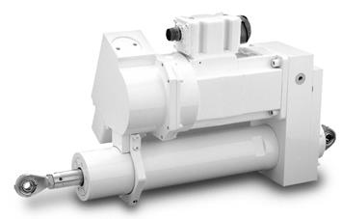
Applications with MPS L-type linear bearings
Packaging
(e.g.: pharmaceutics)
Microtome
Industry:
Soldering machine
Thermal treatment equipment
Semiconductor
Injection modules
High precision machining
Automation
Flight control
Satellites
High volumes

Slide 13
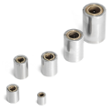
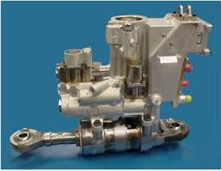
Applications with MPS L-type linear bearings
L-type linear ball bearings
High precision
Standard max 8µm
Reliability
Long life
Miniature
Smallest linear ball bearing in the world
Customization
Radial play, entirely in stainless steel
Low noise
Low friction and great smoothness

Slide 14
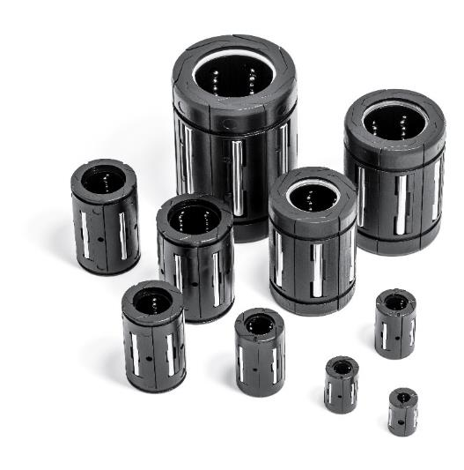
Applications
Linear ball bearings – DBL Line :
Cost-effective
Bore diameter from Ø 0.118in to Ø 0.984in (Ø 3 mm to Ø 25 mm)
No stick-slip effect
Excellent performance consistency when submitted to severe temperature variations

Slide 15
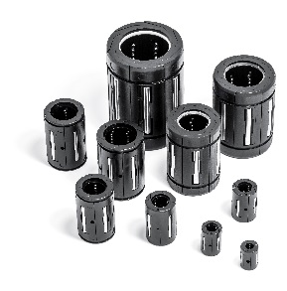
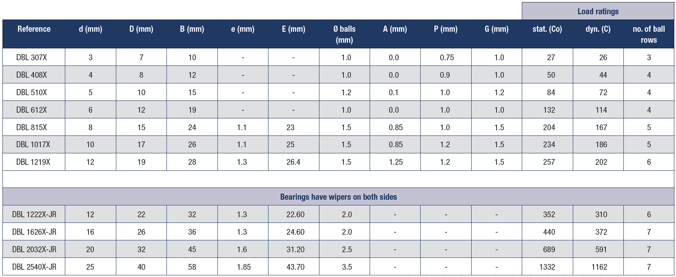
Applications
Precision linear bearings DBL

Slide 16
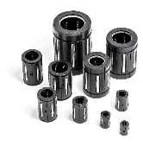
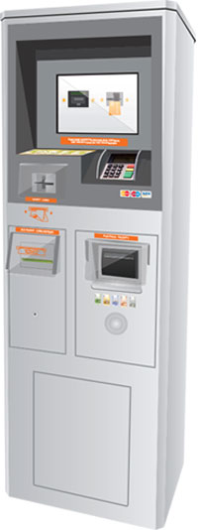
Applications
DBL-type linear ball bearings
Payment terminals

Slide 17
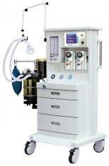
Applications
DBL-type linear ball bearings
Respiratory assistance equipment

Slide 18
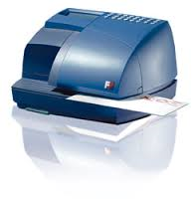
Applications
DBL-type linear ball bearings
Franking machines

Slide 19
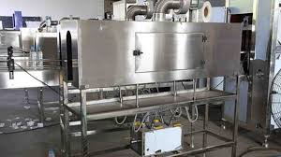
Applications
DBL-type linear ball bearings
Food industry

Slide 20
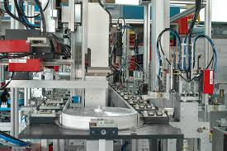
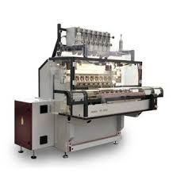
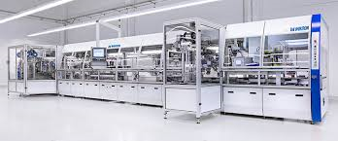
Applications
DBL-type linear ball bearings
Winding machines
Assembly line systems

Slide 21
Applications
DBL-type linear ball bearings
Sliding doors on cable cars

Slide 22
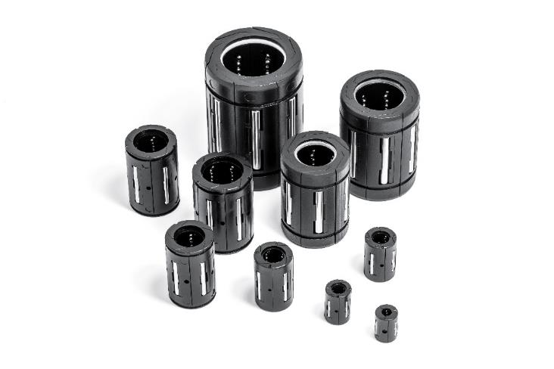
Applications with MPS DBL-type linear bearings
High volumes
Payment terminals
Food industry
Assembly lines
Respiratory assistance
equipment
Winding machines
Franking machines
Sliding doors on cable cars

Slide 23
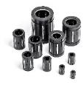
Applications with MPS DBL-type linear bearings
DBL-type linear ball bearings
Insensitive to temperature variations
contact points/Hertz pressure
Comprehensive range
From Ø 0.118in to Ø 0.984in
(Ø 3 mm to Ø 25 mm)
Low friction
Smoothness
No stick-slip effect
Clean and non-corrosive
Ideal for food applications
Low cost

Slide 24
Applications
markets – positioning - strategy
High precision miniature products
Low volumes available to support customers’ product development initiatives, reasonably high prices
→ Niche markets in the high-end segment

Slide 25
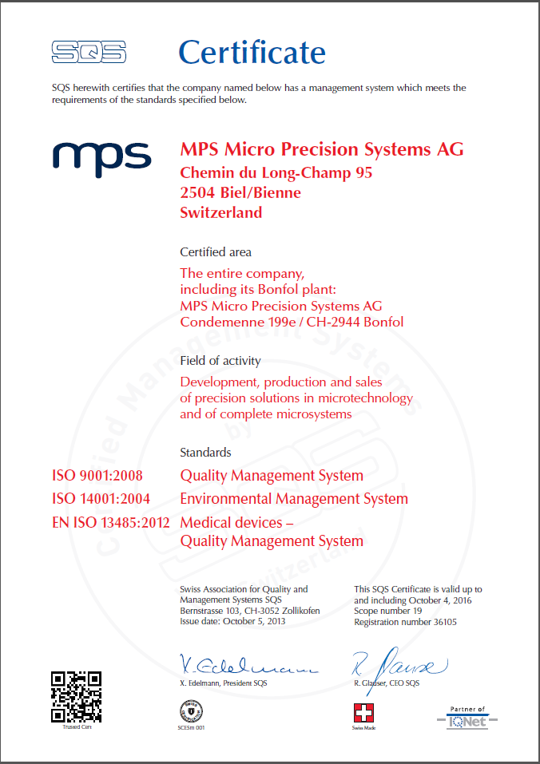
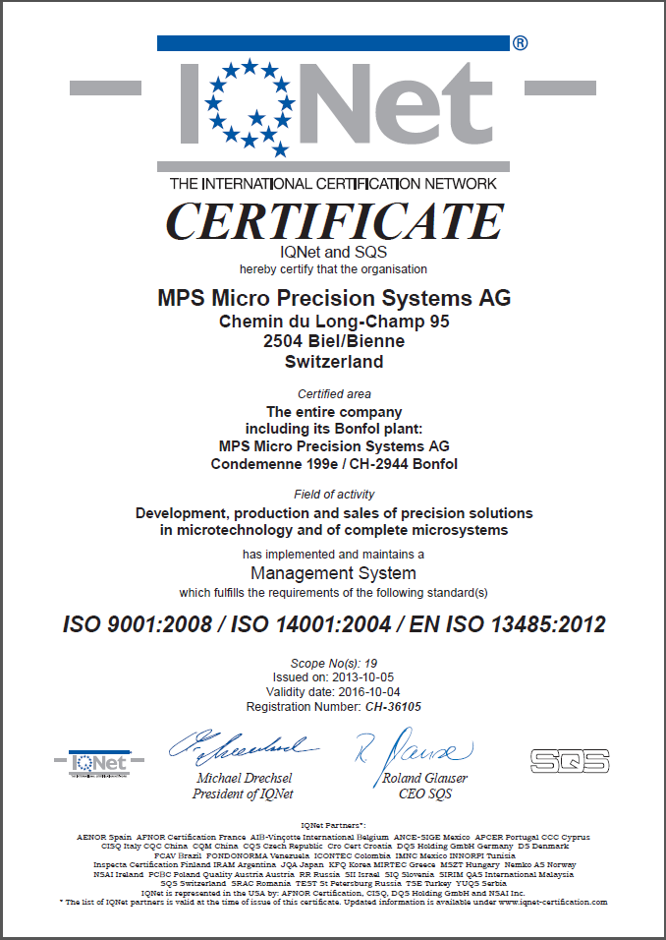
Certifications

Slide 26
Finally…
Why MPS?
85-year-old company
>40 years of experience in precision linear bearings and ball screws
Dedicated team
Owner of technologies
In-house engineering
In-house production
Quality certifications
Active in highly demanding application fields
Optics
Medical
Orthopedics
Aerospace and defense
Accepts low volume business

